Slide 1
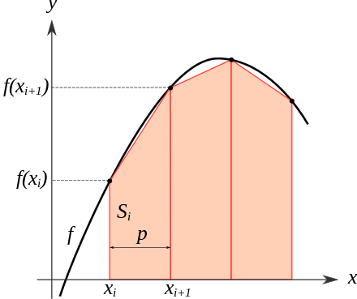

Numerical Integration using scipy

Slide 2
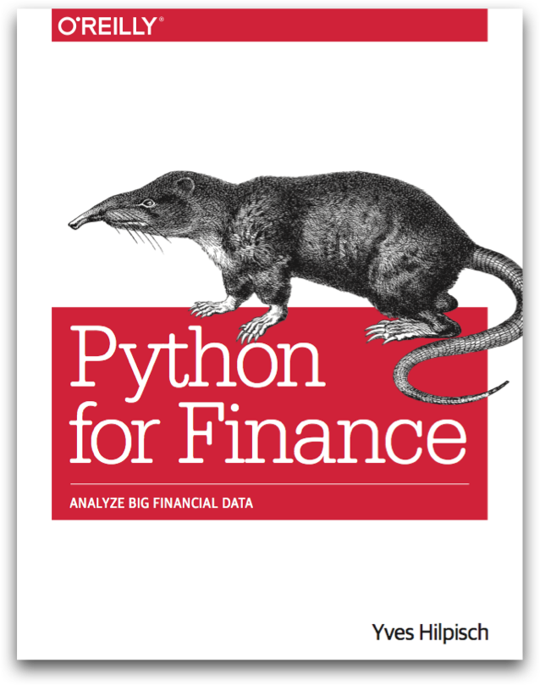
Reference
Chapter 9 of Python for Finance (O'Reilly)
Youtube
Code

Slide 3
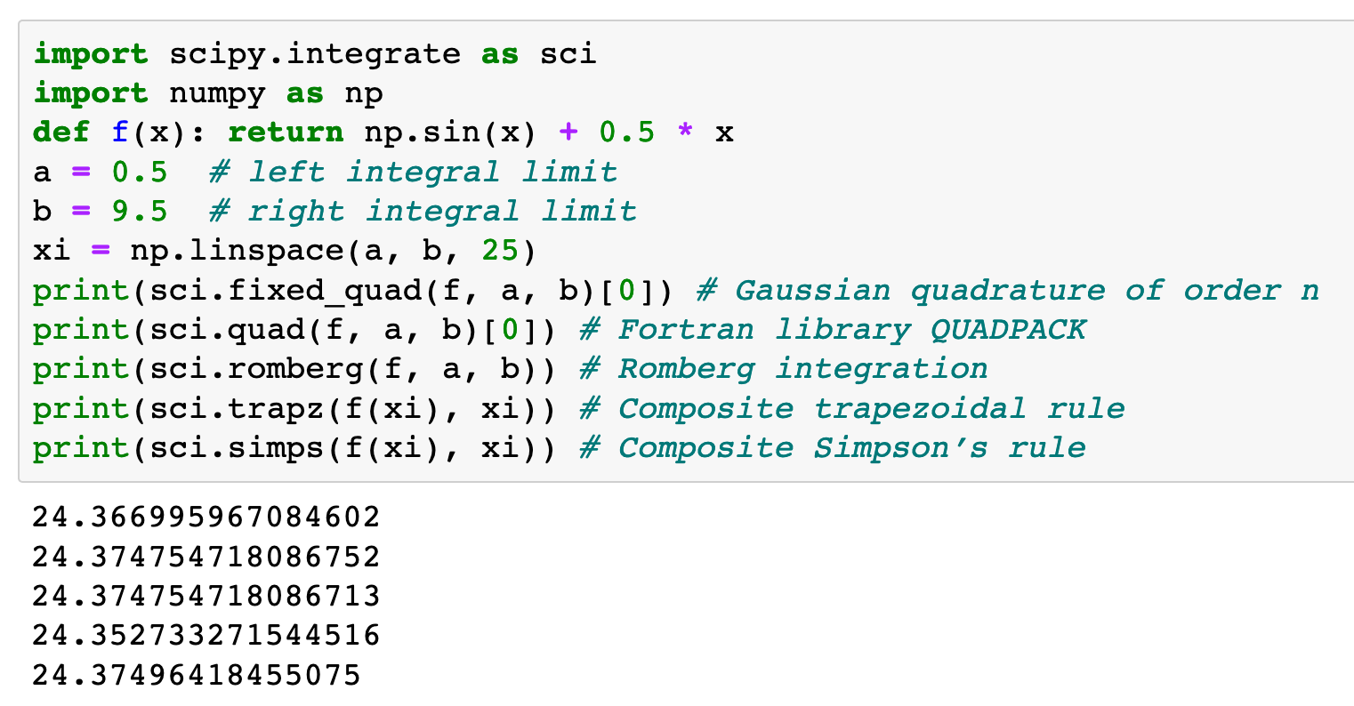

Slide 5


Slide 6
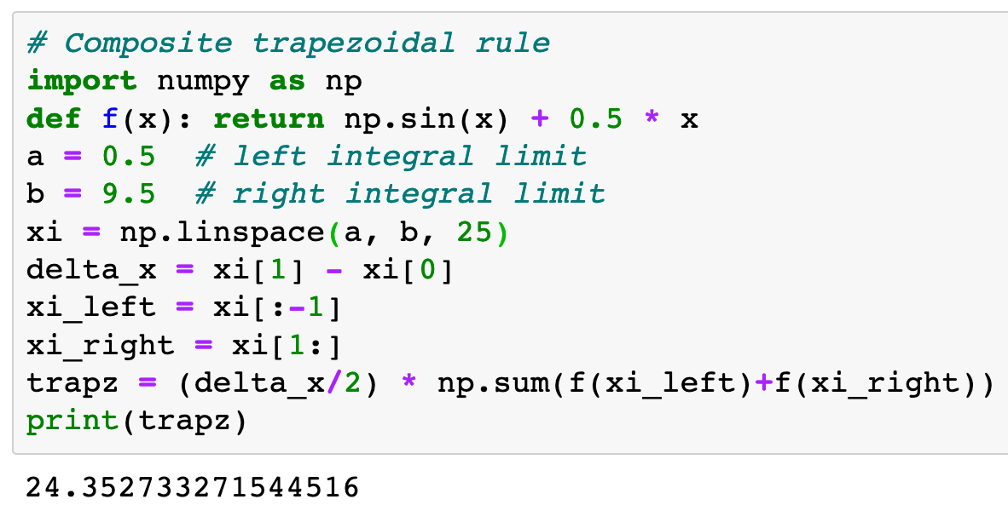

Slide 10
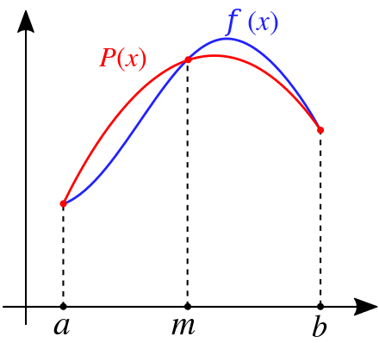

Slide 11


Slide 12

Exercise

Slide 13
Now
Let’s Play with Code

